Slide 1
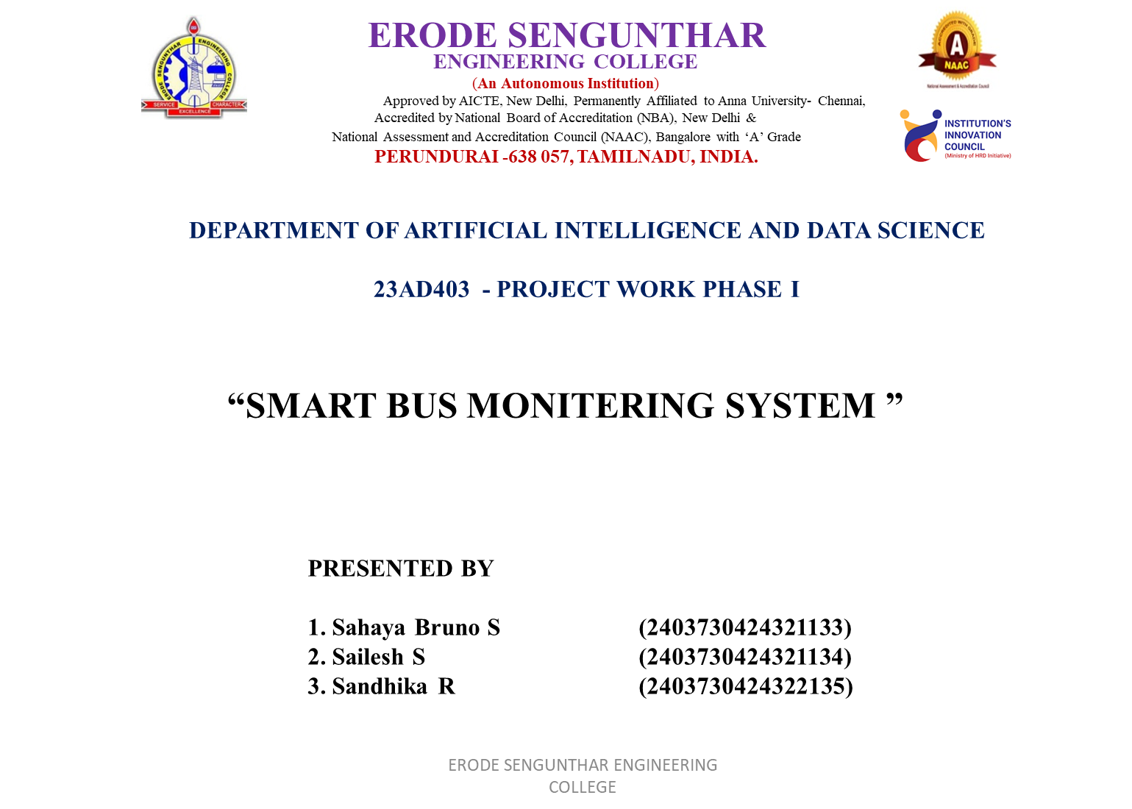

Slide 2
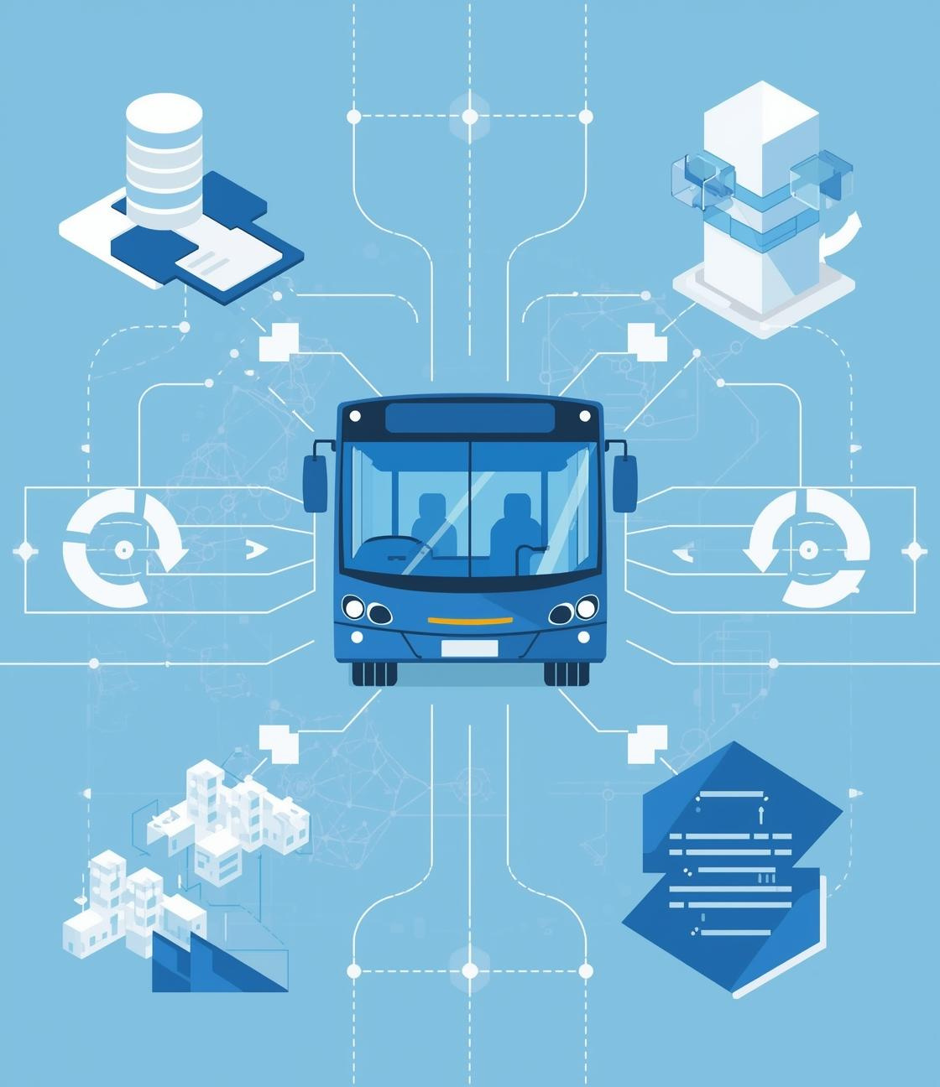

AGENDA
ABSTRACT
INTRODUCTION
OBJECTIVE
LITERATURE REVIEW
PROPOSED WORK
PROPOSED ARCHITECTURE
HARDWARE/SOFTWARE REQUIREMENTS

Slide 3
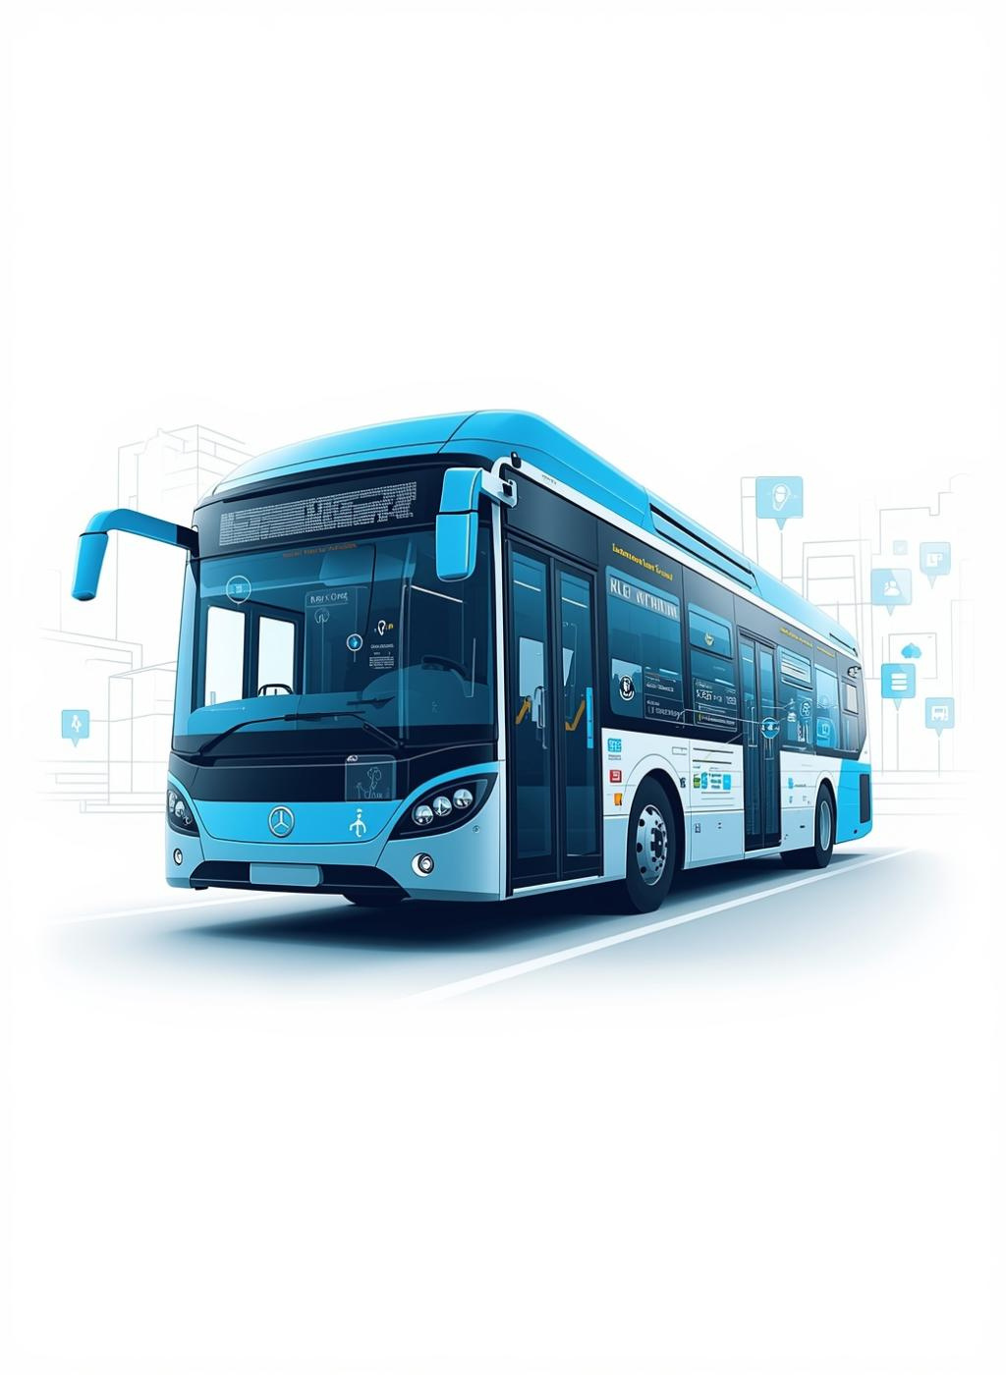
Abstract
Students often face difficulty in knowing the exact location and arrival time of their college bus. In many small projects, bus details are written directly inside the program (hardcoded), which makes updating information difficult and unrealistic. Advanced GPS-based tracking systems are available, but they are expensive and not suitable for simple college-level implementations.
In this project, we propose a Smart Bus Monitoring System using Python and SQLite database. All bus details such as bus number, route, stops, and current location are stored in a database instead of writing them inside the code. The program retrieves data from the database and calculates how many stops are remaining before the bus reaches a selected stop. It then displays a message like “Bus 55 arriving in 2 stops.”
This system is easy to update, more flexible, and gives a real-time feel compared to hardcoded systems. It provides a simple, low-cost, and efficient solution for managing college bus information.

Slide 4
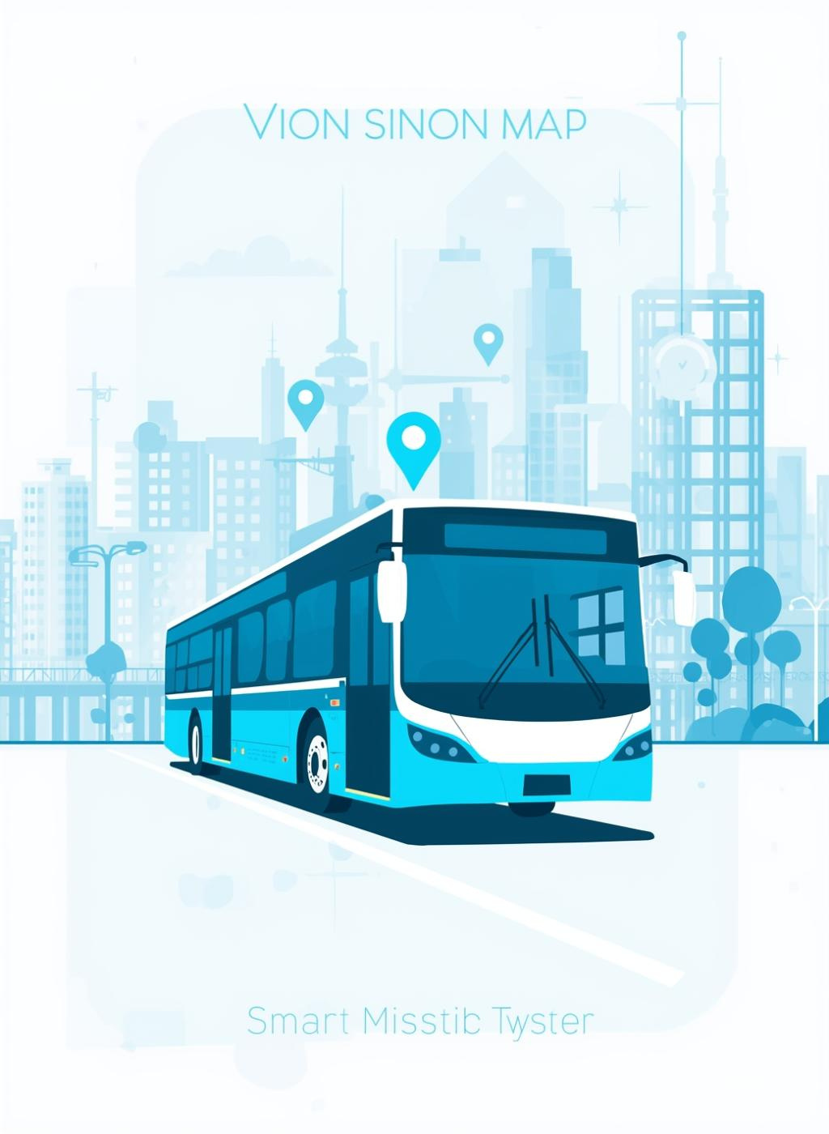
Introduction
Transportation is important for college students, and many depend on college buses daily.
Students often do not know the exact location of the bus or how many stops are remaining, which causes confusion and delay.
In many small projects, bus details are hardcoded in the program, making updates difficult and not flexible.
This project proposes a Smart Bus Monitoring System using Python and SQLite database to store bus details dynamically.
The system calculates remaining stops and displays arrival information, making it more practical and easy to manage.

Slide 5
Objectives
STORE BUS DETAILS
TRACK BUS LOCATION
To store bus and stop details dynamically using SQLite database.
Implementing real-time tracking to enhance user experience and accuracy.
CALCULATE REMAINING STOPS
REPLACE HARDCODED SYSTEM
Dynamic calculations to provide users with accurate arrival predictions.
Transitioning to a flexible system that allows for easier updates and scalability.
IMPROVE ACCURACY
Enhancing user confidence through precise, real-time data and notifications.

Slide 6
Literature Review
GPS LIMITATIONS
Traditional GPS systems are often costly and complex, making them impractical for many applications. Their reliance on expensive hardware limits accessibility for smaller scale transport projects.
HARDCODED SYSTEMS
Many existing bus tracking systems rely on hardcoded data, resulting in inflexibility. These systems lack adaptability, making updates labor-intensive and often leading to outdated information for users.
LACK OF DATABASE INTEGRATION
Some systems do not use a proper database for storing bus and stop information. Without database support, data management becomes inefficient, less organized, and not scalable. This limits the system’s ability to handle real-time updates and future expansion

Slide 7
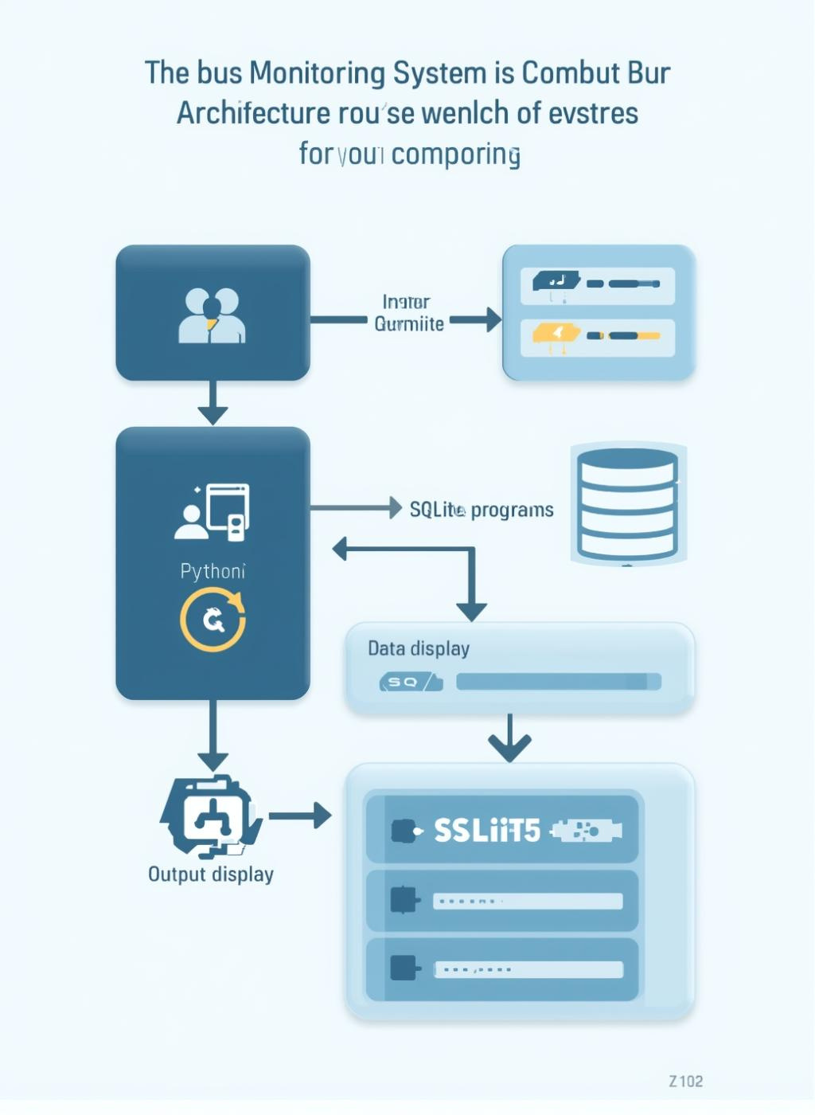
Proposed System
The proposed Smart Bus Monitoring System is designed using Python integrated with an SQLite database to provide a dynamic and efficient solution for college transportation management. The new system architecture utilizes an SQLite database for efficient data storage and retrieval, enabling dynamic tracking of bus locations and improving the user experience with a real-time simulation feel.
In this system, all important details such as bus number, route information, stop names, stop order, and current bus location are stored in structured database tables. This removes the need for hardcoded values inside the program.

Slide 8
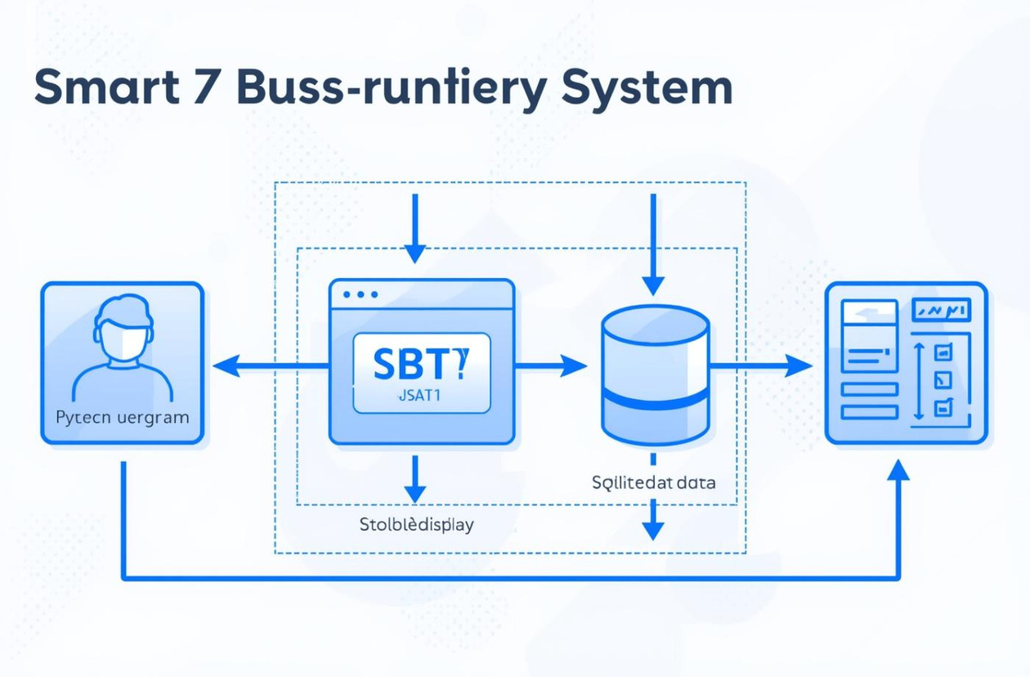
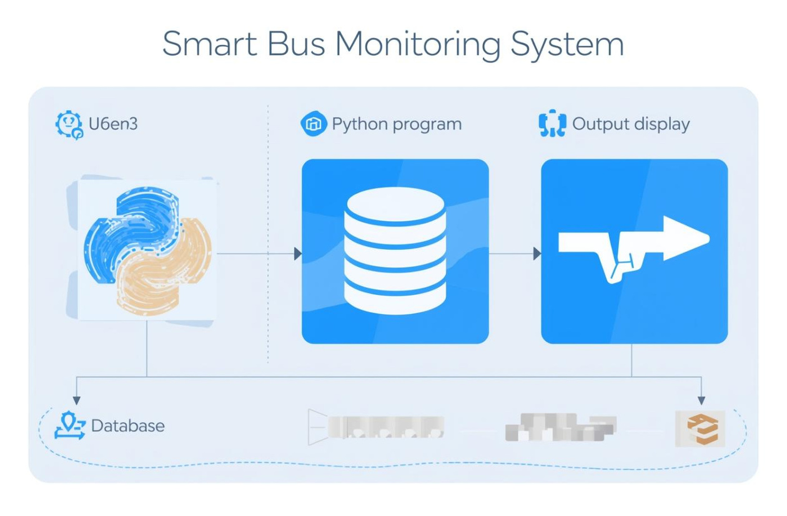
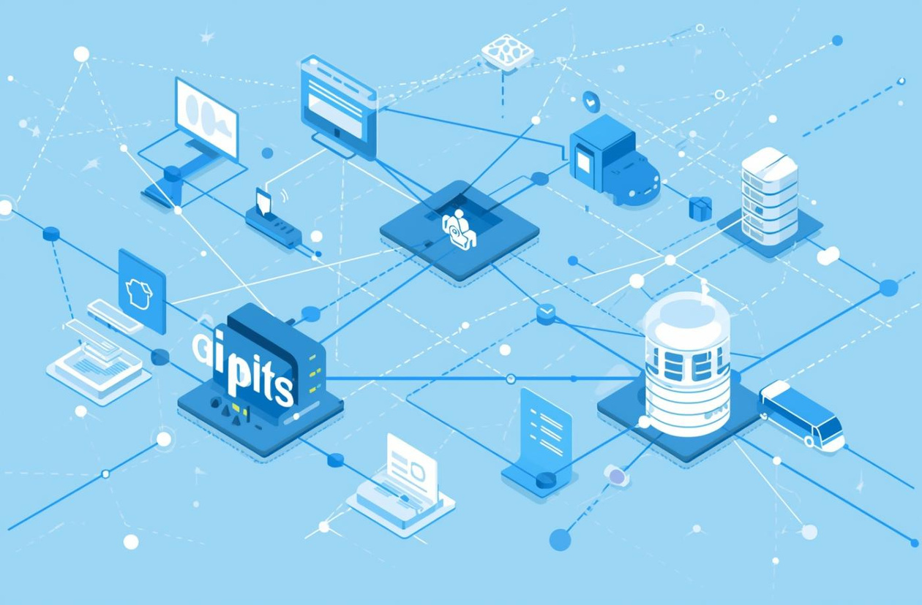
System Architecture
DATA FLOW OVERVIEW
COMPONENT INTERACTION
CONNECTIVITY CONCEPT
Visual representation
System components
Data integration
This diagram illustrates the seamless flow of data through the monitoring system architecture.
This visual highlights the interaction between various system components, ensuring efficient data handling.
This illustration represents the core concept of connectivity and data integration within the system architecture.

Slide 9
HARDWARE REQUIREMENTS
SOFTWARE REQUIREMENTS
Computer / Laptop
Minimum 4 GB RAM
100 GB Hard Disk (minimum)
Processor: Intel i3 or above
Keyboard and Monitor
Operating System: Windows / Linux / macOS
Programming Language: Python
Database: SQLite
IDE: VS Code / PyCharm / IDLE
Python Libraries: sqlite3 (built-in library)

Slide 10
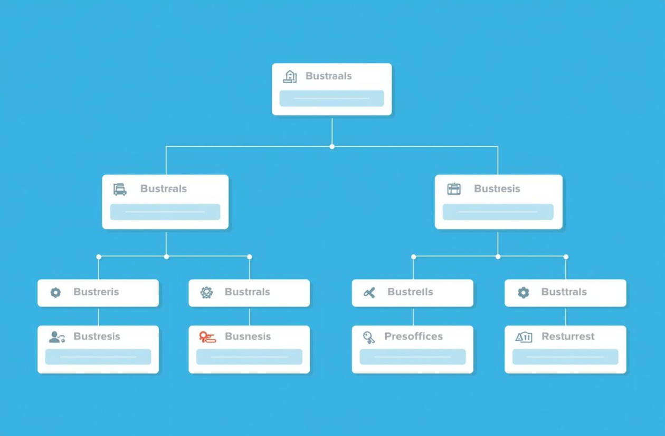
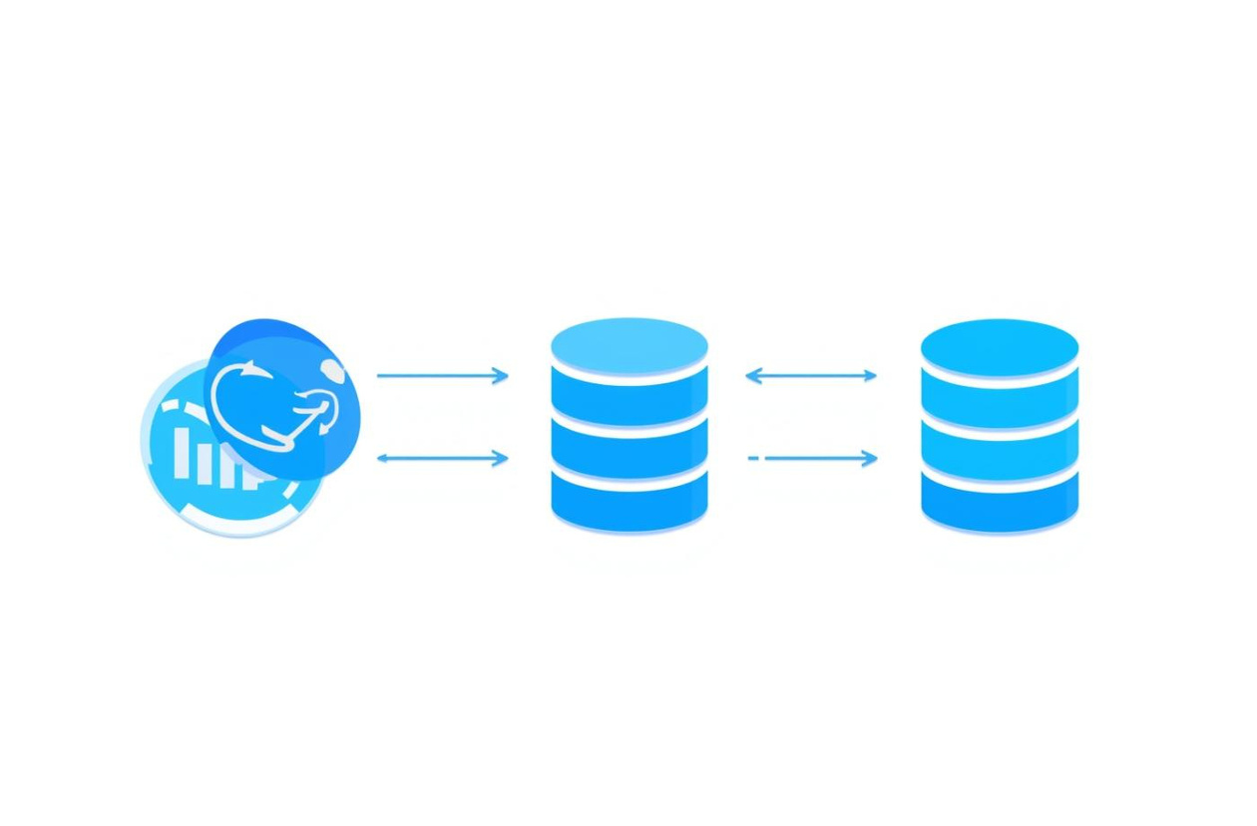
Database Structure
DATABASE SCHEMA
DATA FLOW
Tables and fields
Input and output
This illustration visually represents the structure of the database used for the bus monitoring system.
This image showcases the flow of data within the database, highlighting its dynamic nature.

Slide 11
Advantages of the System
DYNAMIC DATA
EASY UPDATES
Provides real-time updates about bus locations and schedules for users' convenience.
Changes to bus information can be made quickly within the database, enhancing flexibility.
REAL-TIME FEEL
PROFESSIONAL SYSTEM
Users experience immediate access to bus arrival times and locations, improving satisfaction.
The system presents a polished and modern interface, enhancing user trust and reliability.
SCALABLE SYSTEM
The architecture allows for future expansions and integrations with minimal disruption to services.

Slide 12
Future Enhancements
GPS TRACKING
MOBILE APP
Integrating GPS tracking will allow users to view real-time bus locations, enhancing the accuracy of arrival estimates and providing a more reliable travel experience.
Developing a mobile application will enable users to access bus information on-the-go, receive alerts, and enjoy user-friendly features for tracking bus schedules and locations.
SMS ALERTS
WEB DASHBOARD
Implementing SMS alert notifications will keep users informed regarding bus arrivals and delays, ensuring that they receive timely updates directly to their mobile devices.
A web-based dashboard will allow administrators to monitor bus statuses effectively, manage schedules, and provide valuable insights into usage patterns and service optimization.

Slide 13
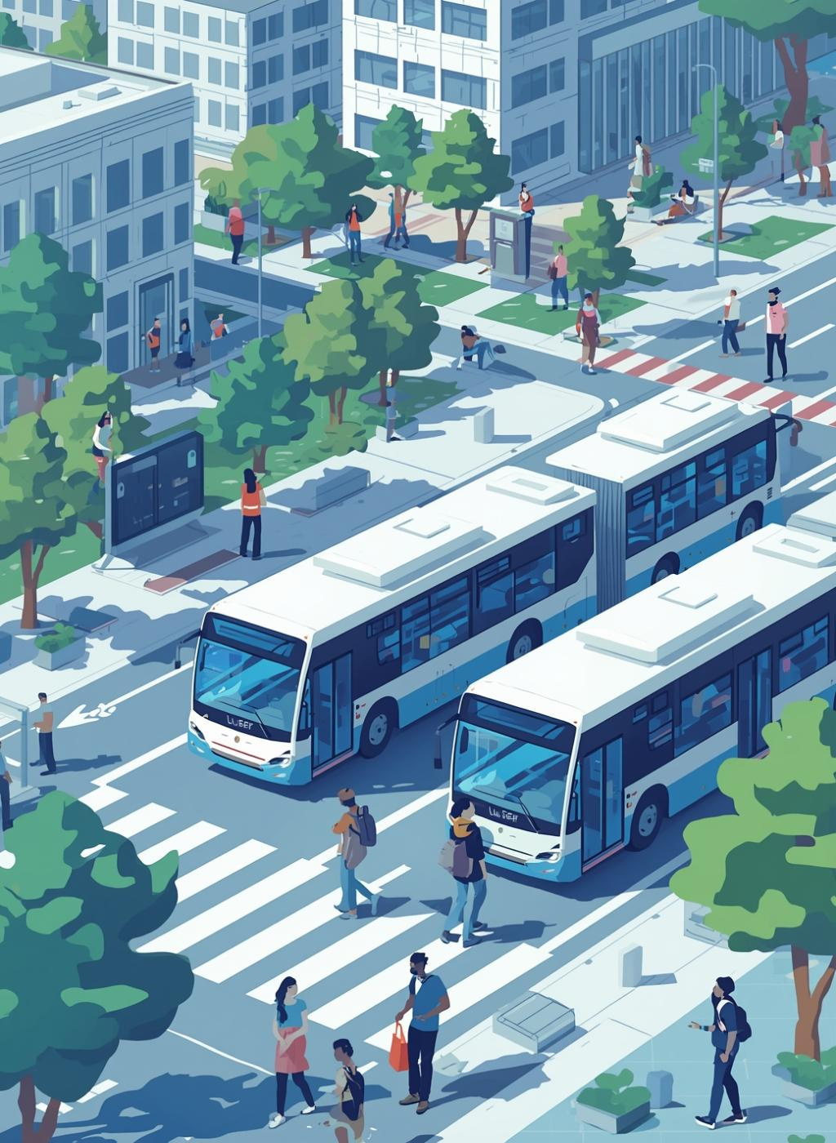
Conclusion
The Smart Bus Monitoring System revolutionizes college transport by replacing rigid systems with a flexible, database-driven approach, enhancing user experience and facilitating scalability for future updates.

Slide 14
Thank You for Your Attention!
WE WELCOME ANY QUESTIONS OR FEEDBACK

